Slide 1
Managing the Organizational Environment

Slide 2
Learning Objectives
Describe the organizational environment
Understand how various environmental forces may influence an organization
Identify the many types of stakeholders that may be affected by or may affect organizational actions
Explain why the ability to monitor, evaluate, and react to the environment is vital for managerial success

Slide 3
Organizational Environment
The internal and external elements that affect an organization make up the organizational environment.
Elements of an organizational environment may include international, legal, and sociocultural forces.

Slide 4
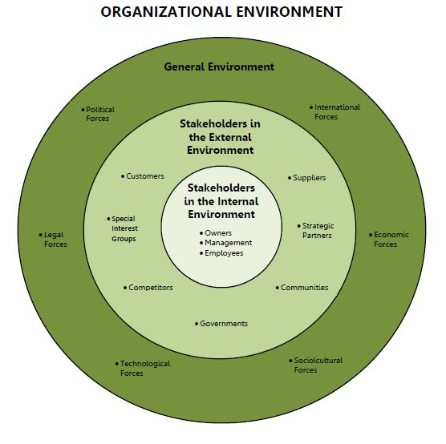

Slide 5
The General Environment
Technological Forces
Tools such as cell phones and the internet have changed the business landscape
Legal and Political Forces
Laws and regulations may alter how an industry operates
Economic Forces
Organizations are impacted by interest rates, inflation, unemployment, income, etc.

Slide 6
The General Environment (cont’d)
Sociocultural Forces
Sociocultural forces are trends from changes in demographics
For example, as the United States has moved towards a healthy lifestyle, the natural foods industry has emerged.
International Forces
Consists of competitors, customers, suppliers, and markets around the world.

Slide 7
YouTube Video
2000s Decade Recap – Business and Technology
How has technology affected commerce in the past twenty years?
Can improvements in technology be a bad thing for businesses? Why or why not?

Slide 8
Internal Stakeholders
Employees
One of the most important stakeholders
Talented and motivated employees can provide a business with a sustainable competitive advantage
Owners
Owners decide where to invest company resources
Influences the day-to-day operations of the business

Slide 9
External Stakeholders
Customers
Lifeblood of a business
May be the most important stakeholder
Suppliers
Provide essential services to an organization
Can have large positive or negative impact
Competitors
Rivalry results in reduced prices and profitability

Slide 10
Managing the Environment
The environment where businesses operate is clearly complex and managers must possess many different skills in order to adapt their organization to an ever-changing world.
Concepts throughout the textbook will help you plan, organize, lead, and control resources in your organizational environment.

Slide 11
What do you think?
Government forces can have a significant impact on the way a business operates.
Do government regulations help or hurt business operations?
What would happen if all government regulations were eliminated?

